Slide 1
Multiple Access
12.<number>
Copyright © The McGraw-Hill Companies, Inc. Permission required for reproduction or display.

Slide 2

Figure 12.1 Data link layer divided into two functionality-oriented sublayers
The upper sublayer is responsible for data link control (a mechanism which provides a link with reliable communication), and the lower sublayer is responsible for resolving access to the shared media.
12.<number>

Slide 3

Figure 12.2 Taxonomy of multiple-access protocols discussed in this chapter
12.<number>

Slide 4
12-1 RANDOM ACCESS
In random access or contention methods, no station is superior to another station and none is assigned the control over another. No station permits, or does not permit, another station to send.
To avoid access conflict or to resolve it when it happens, each station follows a procedure that answers the following questions:
When can the station access the medium?
What can the station do if the medium is busy?
How can the station determine the success or failure of the transmission?
What can the station do if there is an access conflict?
12.<number>

Slide 5
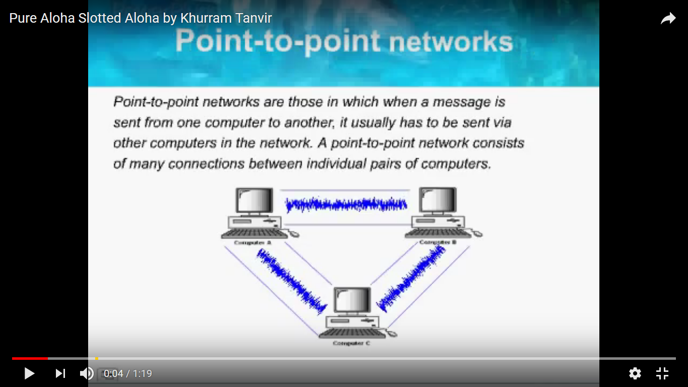
12.<number>

Slide 6
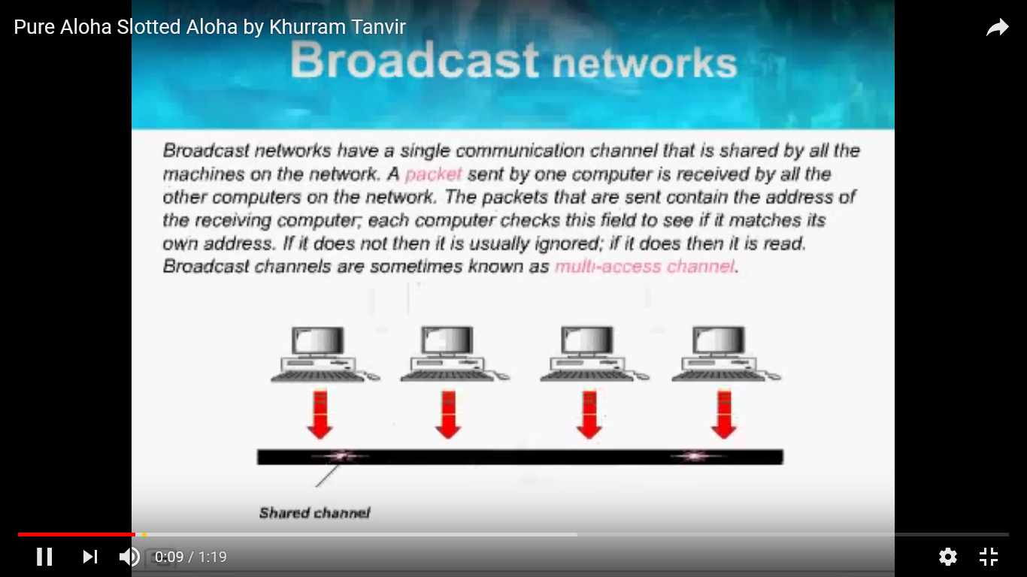
12.<number>

Slide 7
ALOHA
ALOHA, the earliest random access method, was developed at the University of Hawaii in early 1970. It was designed for a radio (wireless) LAN, but it can be used on any shared medium.
12.<number>

Slide 8

Figure 12.3 Frames in a pure ALOHA network
12.<number>

Slide 9
Two frames survive: frame 1.1 from station 1 and frame 3.2 from station 3.
The pure ALOHA protocol relies on acknowledgments from the receiver.
If the acknowledgment does not arrive after a time-out period, the station assumes that the frame (or the acknowledgment) has been destroyed and resends the frame.
12.<number>

Slide 10
A collision involves two or more stations. If all these stations try to resend their frames after the time-out, the frames will collide again
Pure ALOHA dictates that when the time-out period passes, each station waits a random amount of time before resending its frame. The randomness will help avoid more collisions. We call this time the back-off time TB.
Pure ALOHA has a second method to prevent congesting the channel with retransmitted frames
After a maximum number of retransmission attempts Kmax' a station must give up and try later
12.<number>

Slide 11

Figure 12.4 Procedure for pure ALOHA protocol
12.<number>

Slide 12
Example 12.1
The stations on a wireless ALOHA network are a maximum of 600 km apart. If we assume that signals propagate at 3 × 10⁸ m/s, we find
Tp = (600 × 10⁵ ) / (3 × 10⁸ ) = 2 ms.
Now we can find the value of T_{B} for different values of
K .
a. For K = 1, the range is {0, 1}. The station needs to|
generate a random number with a value of 0 or 1. This
means that T_{B} is either 0 ms (0 × 2) or 2 ms (1 × 2),
based on the outcome of the random variable.
12.<number>

Slide 13
Example 12.1 (continued)
b. For K = 2, the range is {0, 1, 2, 3}. This means that T_{B}
can be 0, 2, 4, or 6 ms, based on the outcome of the
random variable.
c. For K = 3, the range is {0, 1, 2, 3, 4, 5, 6, 7}. This
means that T_{B} can be 0, 2, 4, . . . , 14 ms, based on the
outcome of the random variable.
d. We need to mention that if K > 10, it is normally set to
10.
12.<number>

Slide 14

Figure 12.5 Vulnerable time for pure ALOHA protocol
The vulnerable time, in which there is a possibility of collision.
12.<number>

Slide 15
Example 12.2
A pure ALOHA network transmits 200-bit frames on a shared channel of 200 kbps. What is the requirement to make this frame collision-free?
Solution
Average frame transmission time T_{fr} is 200 bits/200 kbps or 1 ms. The vulnerable time is 2 × 1 ms = 2 ms. This means no station should send later than 1 ms before this station starts transmission and no station should start sending during the one 1-ms period that this station is sending.
12.<number>

Slide 16

Note
The throughput for pure ALOHA is
S = G × e ^{−2G} .
The maximum throughput
S_{max} = 0.184 when G= (1/2).
G transmission-attempts per frame-time.
G=ns * nfs * Tp or Tfr
S= 0.135 when G=1
S= 0.152 when G=1/4
12.<number>

Slide 17
Example 12.3
A pure ALOHA network transmits 200-bit frames on a shared channel of 200 kbps. What is the throughput if the system (all stations together) produces
a. 1000 frames per second b. 500 frames per second
c. 250 frames per second.
Solution
The frame transmission time is 200/200 kbps or 1 ms.
a. If the system creates 1000 frames per second, this is 1
frame per millisecond. The load is 1. In this case
S = G× e^{−2 G} or S = 0.135 (13.5 percent). This means
that the throughput is 1000 × 0.135 = 135 frames. Only
135 frames out of 1000 will probably survive.
12.<number>

Slide 18
Example 12.3 (continued)
b. If the system creates 500 frames per second, this is
(1/2) frame per millisecond. The load is (1/2). In this
case S = G × e ^{−2G} or S = 0.184 (18.4 percent). This
means that the throughput is 500 × 0.184 = 92 and that
only 92 frames out of 500 will probably survive. Note
that this is the maximum throughput case,
percentagewise.
c. If the system creates 250 frames per second, this is (1/4)
frame per millisecond. The load is (1/4). In this case
S = G × e −^{2G} or S = 0.152 (15.2 percent). This means
that the throughput is 250 × 0.152 = 38. Only 38
frames out of 250 will probably survive.
12.<number>

Slide 19

Figure 12.6 Frames in a slotted ALOHA network
12.<number>

Slide 20
Note
The throughput for slotted ALOHA is
S = G × e^{−G} .
The maximum throughput
S_{max} = 0.368 when G = 1.
12.<number>

Slide 21

Figure 12.7 Vulnerable time for slotted ALOHA protocol
12.<number>

Slide 22
Example 12.4
A slotted ALOHA network transmits 200-bit frames on a shared channel of 200 kbps. What is the throughput if the system (all stations together) produces
a. 1000 frames per second b. 500 frames per second
c. 250 frames per second.
Solution
The frame transmission time is 200/200 kbps or 1 ms.
a. If the system creates 1000 frames per second, this is 1
frame per millisecond. The load is 1. In this case
S = G× e^{−G} or S = 0.368 (36.8 percent). This means
that the throughput is 1000 × 0.0368 = 368 frames.
Only 386 frames out of 1000 will probably survive.
12.<number>

Slide 23
Example 12.4 (continued)
b. If the system creates 500 frames per second, this is
(1/2) frame per millisecond. The load is (1/2). In this
case S = G × e^{−G} or S = 0.303 (30.3 percent). This
means that the throughput is 500 × 0.0303 = 151.
Only 151 frames out of 500 will probably survive.
c. If the system creates 250 frames per second, this is (1/4)
frame per millisecond. The load is (1/4). In this case
S = G × e ^{−G} or S = 0.195 (19.5 percent). This means
that the throughput is 250 × 0.195 = 49. Only 49
frames out of 250 will probably survive.
12.<number>

Slide 24
The chance of collision can be reduced if a station senses the medium before trying to use it.
Carrier sense multiple access (CSMA) requires that each station first listen to the medium before sending. In other words, CSMA is based on the principle "sense before transmit" or "listen before talk."
12.<number>

Slide 25

Figure 12.9 Vulnerable time in CSMA
12.<number>

Slide 26
What should a station do if the channel is busy?
What should a station do if the channel
is idle?
12.<number>

Slide 27
I-Persistent
The I-persistent method is simple and straightforward. In this method, after the station finds the line idle, it sends its frame immediately This method has the highest chance of collision
12.<number>

Slide 28
Nonpersistent
In the nonpersistent method, a station that has a frame to send senses the line. If the line is idle, it sends immediately. If the line is not idle, it waits a random amount of time and then senses the line again.
12.<number>

Slide 29
p-persistent
The p-persistent method is used if the channel has time slots with a slot duration equal to or greater than the maximum propagation time. The p-persistent approach combines the advantages of the other two strategies.
1. With probability p, the station sends its frame.
2. With probability q = 1 - p, the station waits for the beginning of the next time slot and checks the line again.
12.<number>

Slide 30

Figure 12.10 Behavior of three persistence methods
12.<number>

Slide 31

Figure 12.11 Flow diagram for three persistence methods
12.<number>

Slide 32
Carrier Sense Multiple Access with Collision Detection (CSMA/CD)
station monitors the medium after it sends a frame to see if the transmission was successful. If so, the station is finished. If, however, there is a collision, the frame is sent again.
12.<number>

Slide 33

Figure 12.12 Collision of the first bit in CSMA/CD
12.<number>

Slide 34

Figure 12.13 Collision and abortion in CSMA/CD
12.<number>

Slide 35
Minimum Frame Size
For CSMA/CD to work, we need a restriction on the frame size. Before sending the last bit of the frame, the sending station must detect a collision, if any, and abort the transmission.
This is so because the station, once the entire frame is sent, does not keep a copy of the frame
Therefore, the frame transmission time Tfr must be at least two times the maximum propagation time Tp.
12.<number>

Slide 36
Example 12.5
A network using CSMA/CD has a bandwidth of 10 Mbps. If the maximum propagation time (including the delays in the devices and ignoring the time needed to send a jamming signal, as we see later) is 25.6 μs, what is the minimum size of the frame?
Solution
The frame transmission time is T_{fr} = 2 × T_{p} = 51.2 μs. This means, in the worst case, a station needs to transmit for a period of 51.2 μs to detect the collision. The minimum size of the frame is 10 Mbps × 51.2 μs = 512 bits or 64 bytes. This is actually the minimum size of the frame for Standard Ethernet.
12.<number>

Slide 37

Figure 12.14 Flow diagram for the CSMA/CD
12.<number>

Slide 38
CSMA/CD is similar to the one for the ALOHA protocol, but there are differences.
The first difference is the addition of the persistence process.
In ALOHA, we first transmit the entire frame and then wait for an acknowledgment. In CSMA/CD, transmission and collision detection is a continuous process.
The third difference is the sending of a short jamming signal that enforces the collision in case other stations have not yet sensed the collision.
12.<number>

Slide 39

Figure 12.15 Energy level during transmission, idleness, or collision
12.<number>

Slide 40
Carrier Sense Multiple Access with Collision Avoidance (CSMA/CA)
CSMA/CD is not useful for effective collision detection in wireless mode.
12.<number>

Slide 41

Figure 12.16 Timing in CSMA/CA
12.<number>

Slide 42
Interframe Space (IFS)
First, collisions are avoided by deferring transmission even if the channel is found idle. When an idle channel is found, the station does not send immediately
The IFS variable can also be used to prioritize stations or frame types
12.<number>

Slide 43
Contention Window
The contention window is an amount of time divided into slots. A station that is ready to send chooses a random number of slots as its wait time. The number of slots in the window changes according to the binary exponential back-off strategy.
However, if the station finds the channel busy, it does not
restart the process; it just stops the timer and restarts it when the channel is sensed as idle. This gives priority to the station with the longest waiting time.
12.<number>

Slide 44
Acknowledgment
With all these precautions, there still may be a collision resulting in destroyed data. In addition, the data may be corrupted during the transmission. The positive acknowledgment and the time-out timer can help guarantee that the receiver has received the frame.
12.<number>

Slide 45
Note
In CSMA/CA, the IFS can also be used to define the priority of a station or a frame.
12.<number>

Slide 46
Note
In CSMA/CA, if the station finds the channel busy, it does not restart the timer of the contention window;
it stops the timer and restarts it when the channel becomes idle.
12.<number>

Slide 47

Figure 12.17 Flow diagram for CSMA/CA
12.<number>

Slide 48
12-2 CONTROLLED ACCESS
In controlled access, the stations consult one another to find which station has the right to send. A station cannot send unless it has been authorized by other stations. We discuss three popular controlled-access methods.
Topics discussed in this section:
Reservation
Polling
Token Passing
12.<number>

Slide 49

Figure 12.18 Reservation access method
12.<number>

Slide 50

Figure 12.19 Select and poll functions in polling access method
12.<number>

Slide 51

Figure 12.20 Logical ring and physical topology in token-passing access method
12.<number>

Slide 52
12-3 CHANNELIZATION
Channelization is a multiple-access method in which the available bandwidth of a link is shared in time, frequency, or through code, between different stations. In this section, we discuss three channelization protocols.
Topics discussed in this section:
Frequency-Division Multiple Access (FDMA)
Time-Division Multiple Access (TDMA)
Code-Division Multiple Access (CDMA)
12.<number>

Slide 53
Note
We see the application of all these methods in Chapter 16 when
we discuss cellular phone systems.
12.<number>

Slide 54

Figure 12.21 Frequency-division multiple access (FDMA)
12.<number>

Slide 55
Note
In FDMA, the available bandwidth
of the common channel is divided into bands that are separated by guard bands.
12.<number>

Slide 56

Figure 12.22 Time-division multiple access (TDMA)
12.<number>

Slide 57
Note
In TDMA, the bandwidth is just one channel that is timeshared between different stations.
12.<number>

Slide 58
Note
In CDMA, one channel carries all transmissions simultaneously.
12.<number>

Slide 59

Figure 12.23 Simple idea of communication with code
12.<number>

Slide 60
Figure 12.24 Chip sequences
12.<number>

Slide 61
Figure 12.25 Data representation in CDMA
12.<number>

Slide 62

Figure 12.26 Sharing channel in CDMA
12.<number>

Slide 63

Figure 12.27 Digital signal created by four stations in CDMA
12.<number>

Slide 64

Figure 12.28 Decoding of the composite signal for one in CDMA
12.<number>

Slide 65

Figure 12.29 General rule and examples of creating Walsh tables
12.<number>

Slide 66
Note
The number of sequences in a Walsh table needs to be N = 2^{m}.
12.<number>

Slide 67
Example 12.6
Find the chips for a network with
a. Two stations b. Four stations
Solution
We can use the rows of W2 and W4 in Figure 12.29:
a. For a two-station network, we have
[+1 +1] and [+1 −1].
b. For a four-station network we have
[+1 +1 +1 +1], [+1 −1 +1 −1],
[+1 +1 −1 −1], and [+1 −1 −1 +1].
12.<number>

Slide 68
Example 12.7
What is the number of sequences if we have 90 stations in our network?
Solution
The number of sequences needs to be 2^{m}. We need to choose m = 7 and N = 2⁷ or 128. We can then use 90
of the sequences as the chips.
12.<number>

Slide 69
Example 12.8
Prove that a receiving station can get the data sent by a specific sender if it multiplies the entire data on the channel by the sender’s chip code and then divides it by the number of stations.
Solution
Let us prove this for the first station, using our previous four-station example. We can say that the data on the channel
D = (d1 ⋅ c1 + d2 ⋅ c2 + d3 ⋅ c3 + d4 ⋅ c4).
The receiver which wants to get the data sent by station 1 multiplies these data by c1.
12.<number>

Slide 70

Example 12.8 (continued)
When we divide the result by N, we get d1 .
12.<number>

